Slide 1
CEF 440: INTERNET PROGRAMMING AND MOBILE PROGRAMMING
Group 22

Slide 2
Outline
Introduction
Major types of mobile apps and their differences
Comparing mobile app programming languages
Mobile app development frameworks comparison using key features (language, performance, cost and time to market, UI and UX, complexity, community support)
Mobile application architecture and design patterns
Requirement Engineering
Estimating the Cost of a Mobile Application Development Project

Slide 3
I. Introduction
What is an application?
An application is software that helps you exchange information with customers and help them complete specific tasks.
What is a mobile application?
A mobile application is an application that is designed to run on mobile devices.

Slide 4
II. Major types of mobile apps and their differences
Mobile apps can be categorized into three major types:
native apps
progressive web apps (PWAs)
hybrid apps

Slide 5
Native Applications
These are apps are designed and optimized for a particular operating system or platform.
A. Characteristics
They have access to all the device features.
They are built using native languages such as Java or Kotlin for android and swift or objective-c for ios.
They can be accessed by downloading either from play store or App Store.

Slide 6
Native Applications
B. Advantages
Highest performance and responsiveness as apps are optimized for the specific platform.
Full access to native device features and APIs.
Enhanced user experience and platform-specific design.

Slide 7
Native Applications
C. Disadvantages
Higher development and maintenance costs as separate codebases need to be maintained for each platform.
Longer development timeframes due to platform-specific development.
Less code reusability between platforms.

Slide 8
Hybrid Applications
These are mobile apps built using web technologies (HTML, CSS and JavaScript) and then wrapped in a native container.
A. Characteristics
They can be accessed by downloading from either Google play store or app store.
They access native device features via plugins.

Slide 9
Hybrid Applications
B. Advantages
Code is written once and can be deployed across multiple platforms/operating systems.
Faster development time as a single codebase is used.
Less costly compared to native apps
Easier maintenance and updates as changes can be applied universally.

Slide 10
Hybrid Applications
C. Disadvantages
Slightly lower performance compared to native apps due to the WebView layer.
Limited access to native device features, requiring the use of plugins or additional libraries.
UI may not look and feel entirely native, potentially impacting user experience. Also there are usually issued achieving the same level of UI/UX across both platforms. E.g. for react native, when you give a text a border radius, it applies in android but not in ios as it doesn’t support border radius for text elements.

Slide 11
Progressive Web Apps
A pwa is a type of web app that can operate as a website and a mobile application on any device.
A. Characteristics
They are built using technologies such as HTML, CSS and JavaScript
They are accessed via the browser, but can be saved into your device for use.
They have limited access to device features compared to native apps.
They enable push notifications

Slide 12
Progressive Web Apps
B. Advantages
Cross-Platform Compatibility
Lower costs and development time
Easy Deployment and Updates
Offline Functionality
Discoverability
App-Like Experience

Slide 13
Progressive Web Apps
C. Disadvantages of PWAs
Limited Access to Native Capabilities
PWAs may not always match the performance of native apps, especially for computationally intensive tasks or graphics-intensive applications.
Limited App Store Distribution

Slide 14
Making a choice (Native, Hybrid or PWA)
App Complexity
Target Platforms
Development Resources and Time Constraints
Offline Capabilities
App Distribution
Update and Maintenance

Slide 15
III. Comparing mobile app programming languages
.
Native apps Swift (ios) Objective-c (ios) Kotlin (android) Java (android) Example AirBnB (Swift and Kotlin) | Hybrid apps React native Ionic Apache Cordova Examples of popular hybrid apps include Facebook (react native), Microsoft Teams (ionic), AirBnB(React Native), Salesforce, Trello, and Slack.

Slide 16
III. Comparing mobile app programming languages
.
PWA apps HTML CSS and JavaScript Some examples of popular PWAs include Twitter Lite, LinkedIn Lite, and Google Maps Go. | Cross Platform apps All hybrid languages/frameworks are cross platform. Flutter Xamarin (C#, C++) Unity (C#)

Slide 17
IV. Mobile app development frameworks comparison using key features
What is a Mobile Framework?
This is a framework for development of application meant to run on mobile devices and operating systems. There exist many different mobile frameworks with each excelling in different features but the most popular will follow below:
React Native, Flutter, Ionic, Xamarin, Apache Cordova, NativeScript, JQuery Mobile.

Slide 18
What to consider before choosing a mobile framework
A. Language
B. Performance
C. Cost and Time to Market
D. UI/UX
E. Complexity
F. Community Support

Slide 19
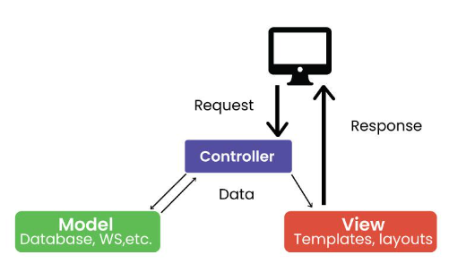
V. Mobile application architecture and design patterns
A. Model-View-Controller (MVC) Architecture

Slide 20
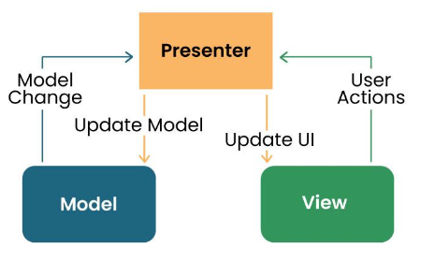
V. Mobile application architecture and design patterns
B. Model View Presenter (MVP) Architecture

Slide 21
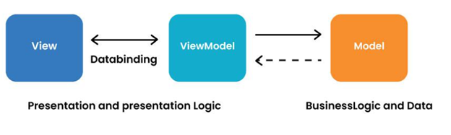
V. Mobile application architecture and design patterns
C. Model View View-Model (MVVM)
D. Clean architecture

Slide 22
V. Mobile application architecture and design patterns
Design patterns
A. Singleton pattern
B. Factory pattern
C. Observer pattern
D. Adapter pattern
E. Strategy pattern
F. Decorator pattern

Slide 23
VI. Requirement Engineering
Introduction
Requirements engineering is a crucial phase in the development of mobile applications. It involves gathering, documenting, analyzing, and validating user requirements to ensure that the final product meets user expectations. In this document, we will provide a step-by-step guide to effectively collect and analyze user requirements for mobile applications.

Slide 24
VI. Requirement Engineering
.
Step-by-step Guide Scope and Objectives Stakeholder Identification User Research User Personas Requirement Elicitation | Categorization and Prioritization Requirement Documentation Requirement Validation Requirement Analysis and Refinement Review and Approval Conclusion

Slide 25
VII. Estimating the Cost of a Mobile Application Development Project
Introduction:
Estimating the cost of a mobile application development project is a critical step in planning and budgeting. Accurate cost estimation helps stakeholders allocate resources effectively and make informed decisions. In this guide, we will outline the key factors to consider and steps to follow when estimating the cost of a mobile application.

Slide 26
VII. Estimating the Cost of a Mobile Application Development Project
Define Project Requirements: Break Down the Project: Evaluate Development Approach: Determine Resource Requirements: Estimate Development Effort: Consider External Costs: Account for Testing and Quality Assurance | Factor in Maintenance and Support: Consider Project Management: Contingency Planning Review and Refine Document and Present the Estimate Conclusion
.

Slide 27
THE END!

